Slide 1



Agriculture, pastoralism, and forest management in plant conservation
Joelle Salameh, Program Manager at the AIFM
Limassol, 8 April 2025

Slide 2
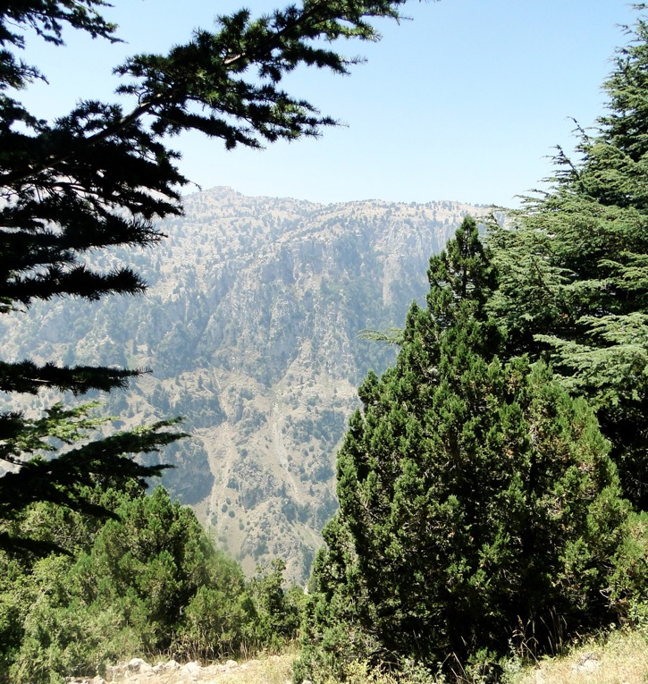
Presentation of AIFM
  International Association for Mediterranean Forests
  NGO based in France since 1996
  Create a linkage between actors in the region to preserve the heritage of the Mediterranean forests through cooperation projects and dissemination of know-how
  Raise public awareness on the challenges of sustainable management of the Mediterranean forests

Slide 3
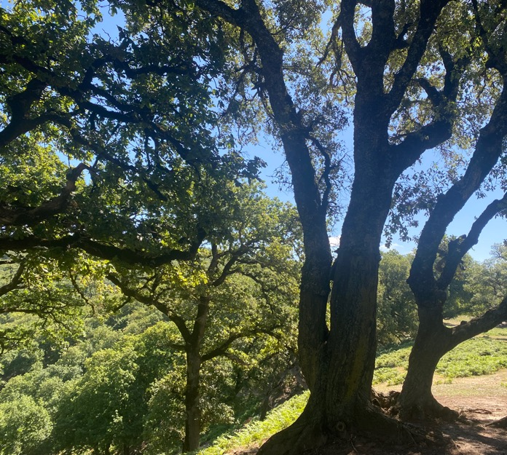
Importance of Forest Ecosystems
Carbon Sequestration: Forests as crucial carbon sinks in mitigating climate change.
Water Regulation: Influence on hydrological cycles, water quality, and flood prevention.
Habitat Stability: Providing shelter, breeding grounds, and resources for a vast array of species, particularly native flora.
Healthy forest ecosystems help in the maintenance of plant diversity.

Slide 4
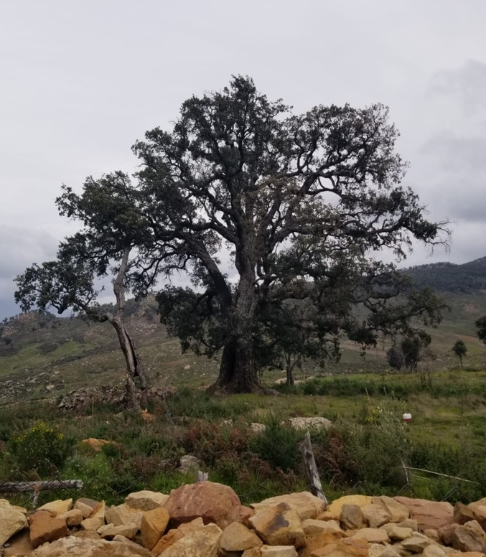
Looming Threat: Biodiversity Loss and Environmental Degradation
  Deforestation and land conversion: agricultural lands, urbanization.
  Forest wildfires: 400,000 ha burned every year in the Mediterranean region
  Unsustainable resource extraction: Over-harvesting of timber and non-wood forest products.
  Pest outbreaks
Reduced plant diversity, disrupted hydrology, increased CO₂ emissions

Slide 5
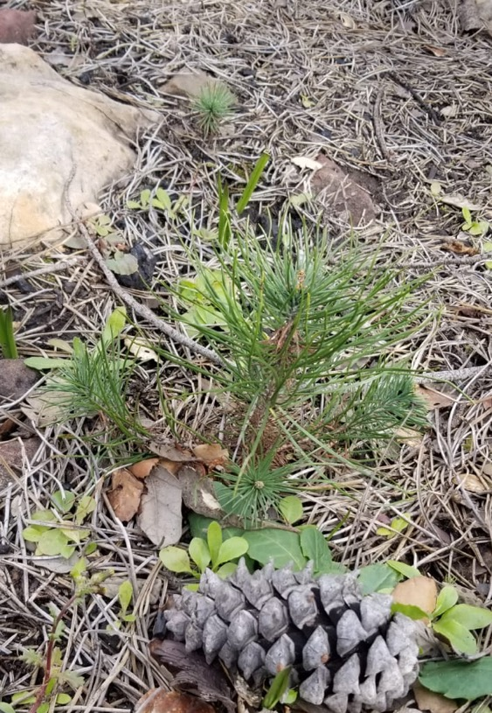
Defining Sustainable Forest Management (SFM)
  Maintain and enhance the long-term health and resilience of forest ecosystems.
  Conserve biodiversity, including native flora.
  Provide socio-economical benefits for present and future generations.
Need to integrate conservation principles with socio-economic considerations

Slide 6
Defining Sustainable Forest Management (SFM)
  Maintaining Natural Forest Structure and Composition
  Conserving Key Habitats and Rare/Endangered Species
  Minimizing Disturbance
  Controlling Invasive Alien Species
  Promoting Natural Regeneration
Notes:
Maintaining Natural Forest Structure and Composition: Promoting diverse age classes, species richness, and structural complexity.
Protecting Key Habitats and Rare/Endangered Species: Establishing protected areas, buffer zones, and implementing targeted conservation measures.
Minimizing Disturbance: Employing low-impact harvesting techniques and reducing soil compaction.
Controlling Invasive Alien Species: Preventing their introduction and managing existing populations.
Promoting Natural Regeneration: Favoring natural processes for forest renewal.

Slide 7
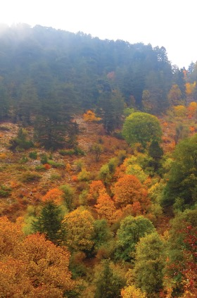
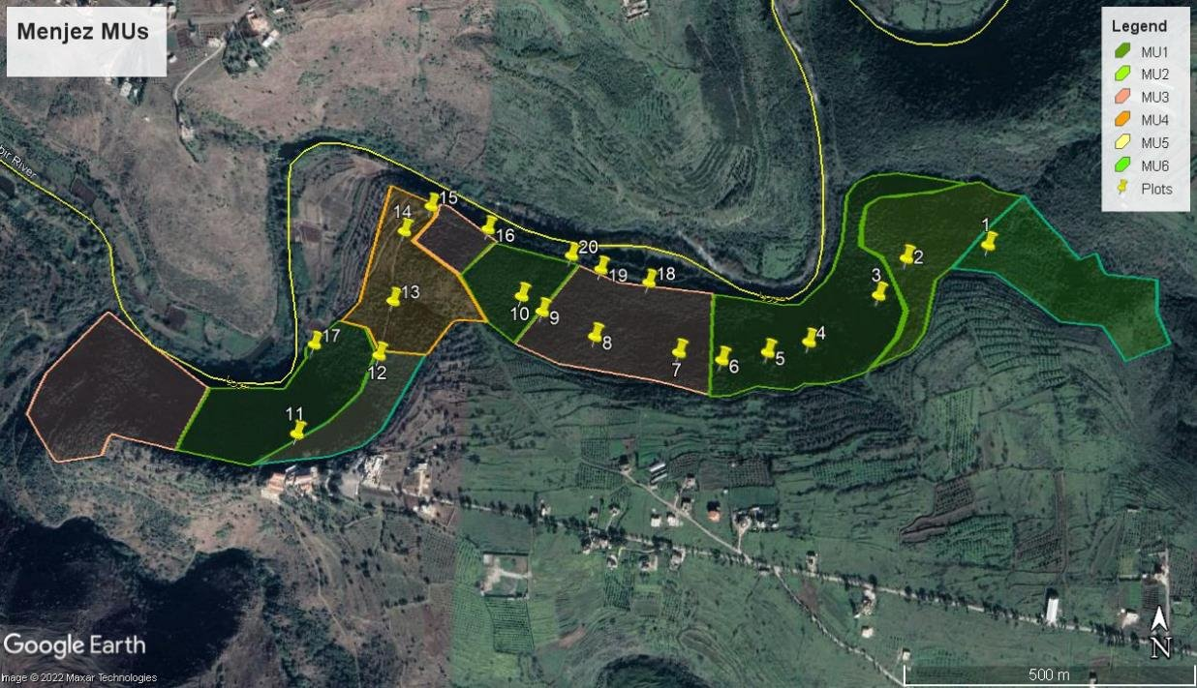
RESTOR’MED FORESTS Lebanon - Menjez
Field work to collect scientific data
Community need assessment (roundtables with key stakeholders)
Notes:
Black forest (laurus nobilis): 20 sampling plots covering all the variability of the forest density, forest age and structure and the physical environment characteristics.
MU1 objectif is to have a mixed bay laurel and wood production - Thinning and pruning of laurel leaves by removing 10% annually
Canopy density is beyond 70% while diameter reached 10cm → regeneration cut, in which a clear cutting is conducted. Since the community wishes to exploit non wood forest products such as laurel essential oil and leaves, the clear-cutting stage depends on the diameter and is optional because the regeneration of laurel is already existing in the understory

Slide 8

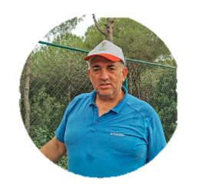
RESTOR’MED FORESTS Lebanon - Testimonials
Joseph Mkhael
“Now, we have faith in the success of any environmental project, when we have patience and faith, we could succeed”.
Charbel Matta
“By employing the local community, they are now part of the reserve and care for its protection”.

Slide 9
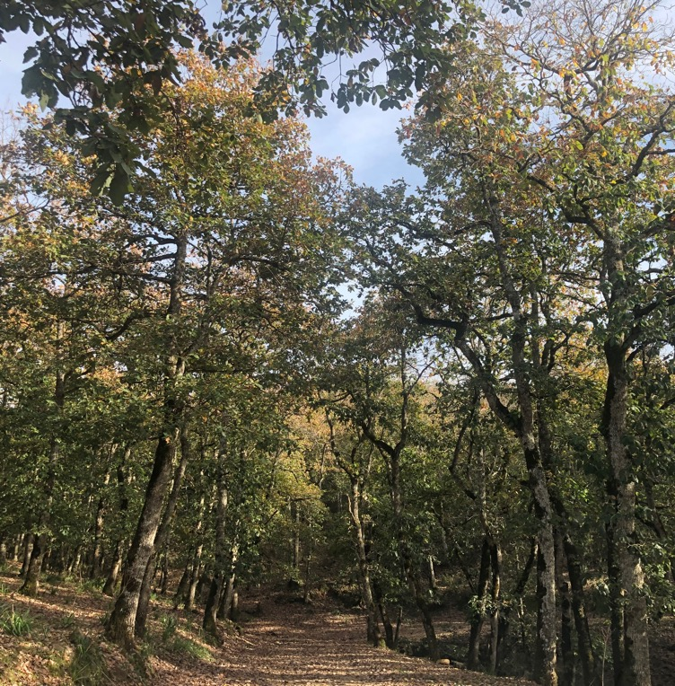
Community-Based Management Models
  Participatory Decision-Making: Involving communities in planning, implementation, and monitoring of forest management activities.
  Sustainable Harvesting Practices: Based on traditional ecological knowledge and the dependence of the communities on the forest resources
  Land-Use Planning: Collaboratively developing strategies that balance conservation with community needs.

Slide 10

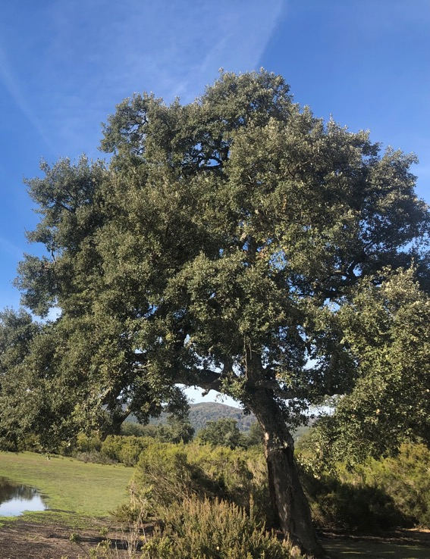
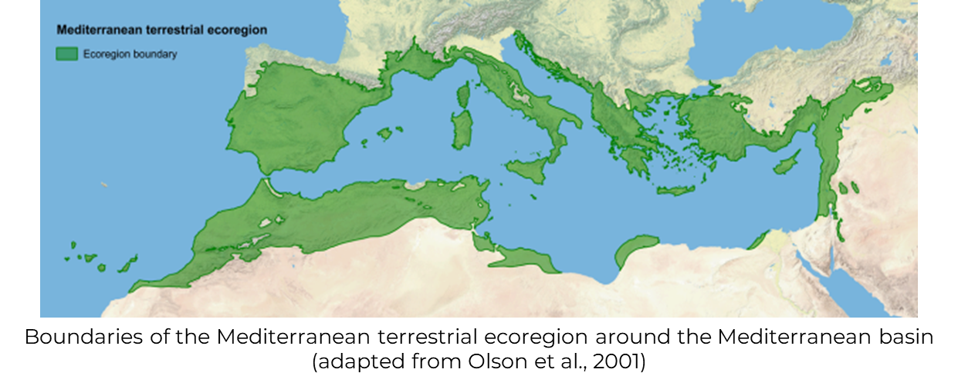







StrategyMedFor
  Sustainable Management of Mediterranean Forests (SMMF) requires a framework that integrates environmental, social and economic dimensions specifically tailored to the region’s unique characteristics

Slide 11
StrategyMedFor
  Systemic review and analysis of scientific literature, policy documents and case studies on C&I for SFM
  Comprehensive stakeholder engagement
  Forest Europe Criteria as a guiding framework for the SMMF + proposed supplementary indicators

Slide 12

StrategyMedFor
Actively involving local communities

Slide 13
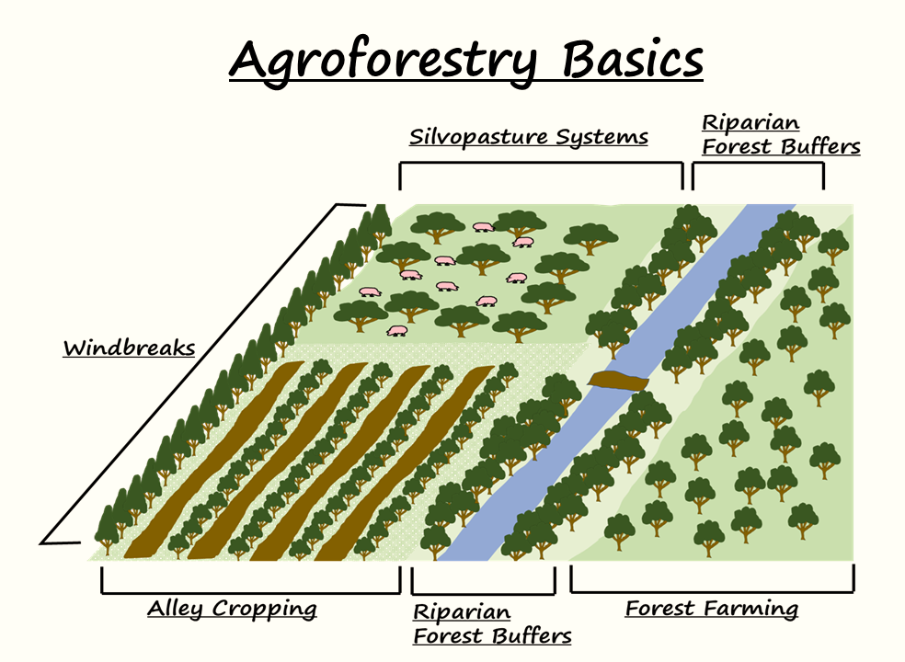
Beyond Forest Management: Integrating Agroforestry
  Agroforestry = integrated land-use systems that combine forest and fruit trees with crops and/or livestock
  Improve Soil Health
  Regulate Hydrological Cycles
  Promote Plant Diversity
  Support Livelihoods
Notes:
Improve Soil Health: Through nutrient cycling and reduced erosion.
Regulate Hydrological Cycles: Enhancing water infiltration and reducing runoff.
Promote Plant Diversity: Creating diverse habitats.
Support Livelihoods: Diversifying income sources and enhancing food security.

Slide 14
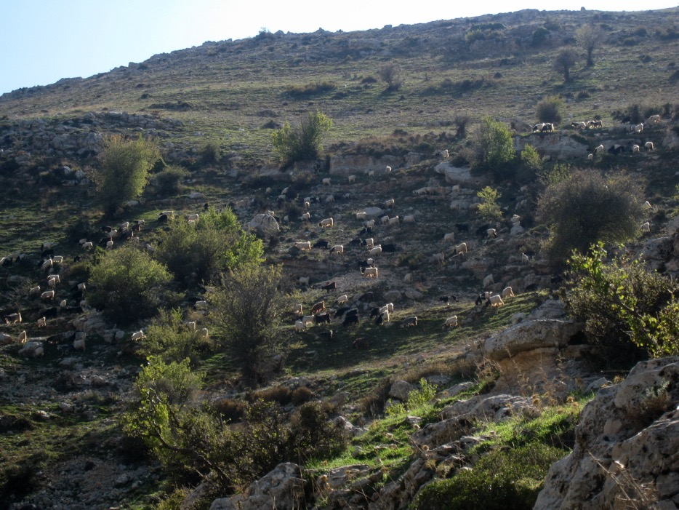
Role of Sustainable Pastoralism
  Well managed grazing contribute to landscape resilience
  Calculate livestock carrying capacity is necessary to avoid overgrazing and soil degradation
@ Jean Stephan, Lebanon
Need for sustainable grazing practices that are integrated with forest management objectives

Slide 15
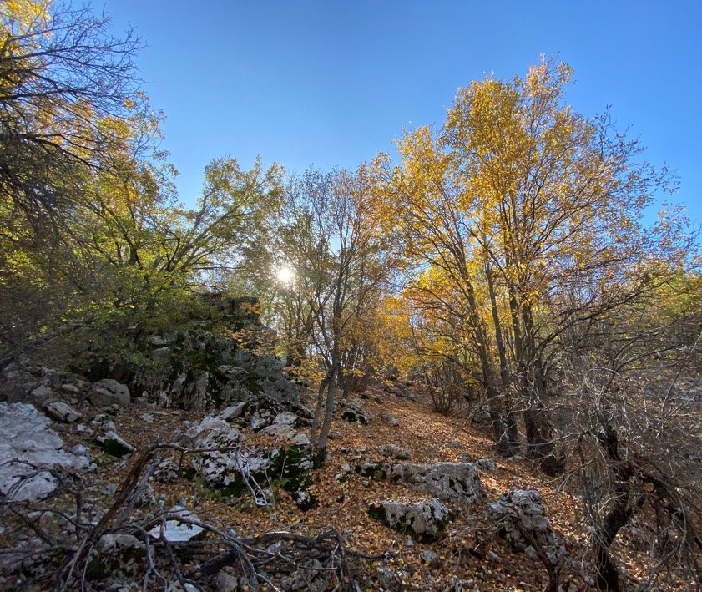

Integradiv
  Identify spatial patterns of tree, bird and butterfly biodiversity and their drivers, in Euro-Mediterranean woodlands.
  Engage with stakeholders to outline a spatially-explicit prioritization plan that will allow protecting the unique biodiversity and socio-cultural inheritance of this region.
Disseminate the scientific information to the public

Slide 16
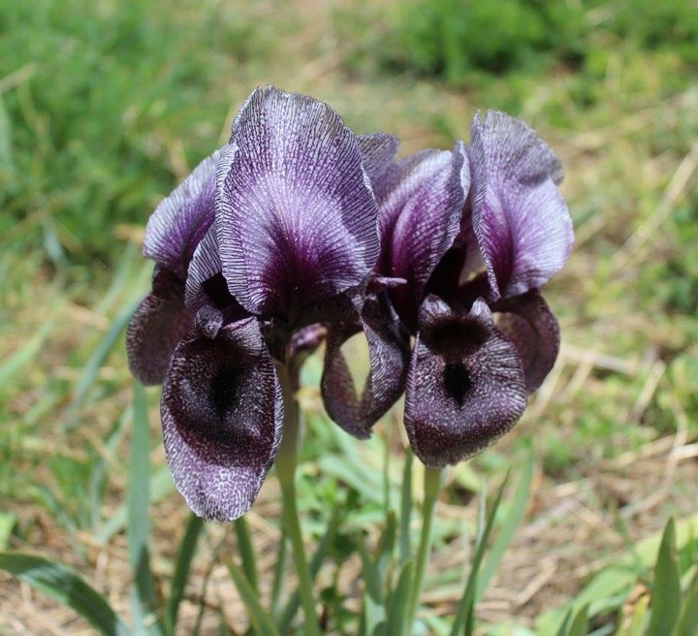
Conclusion: A Path Towards Long-Term Plant Biodiversity Conservation – Key Takeaways
  SFM is critical in addressing biodiversity loss and environmental degradation.
  Importance of integrating conservation principles with socio-economic considerations.
  Role of local communities in effective resource management.
  Develop land-use strategies that consider the interactions between different sectors to enhance landscape resilience and plant diversity.

Slide 17
The Future of Plant Biodiversity Conservation
  Continued research and innovation in sustainable land management practices.
  Strong policy frameworks that support SFM and community involvement.
  Increased collaboration between stakeholders, including governments, local communities, researchers, and NGOs.
  A holistic and integrated approach to land management to ensure the long-term conservation of plant biodiversity for future generations.

Slide 18
THANK YOU
Joelle Salameh,
Program Manager at the AIFM
joelle.salameh@aifm.org

